Slide 1
Machine Learning Classifiers
By: Bryan Gutierrez and Zach Later

Slide 2
Dataset & Goal
Adult Income dataset (UCI)
Task: predict whether income > $50k
32,561 training rows, 16,281 test rows

Slide 3
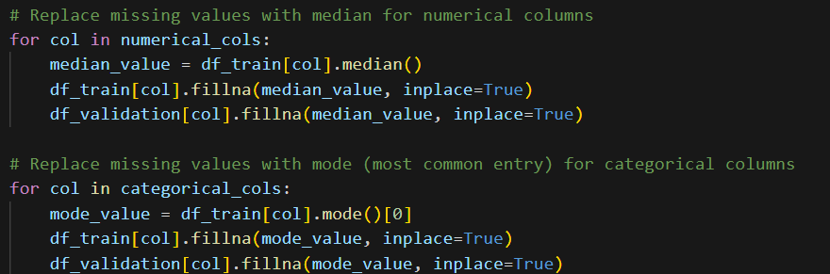
Preprocessing Steps- Missing values
Missing values: Replace with Median and Mode

Slide 4
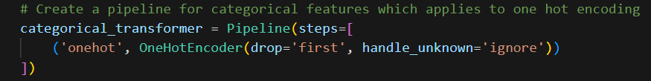
Preprocessing Steps- Categorical variables
Categorical variables: one-hot encoded

Slide 5
Preprocessing Steps- Numerical variables
Transform the 'income' column from categorical ('<50K', '>50K') to a binary representation.

Slide 6
Preprocessing
Why? - Models like Perceptron/Adaline need scaled inputs to converge

Slide 7
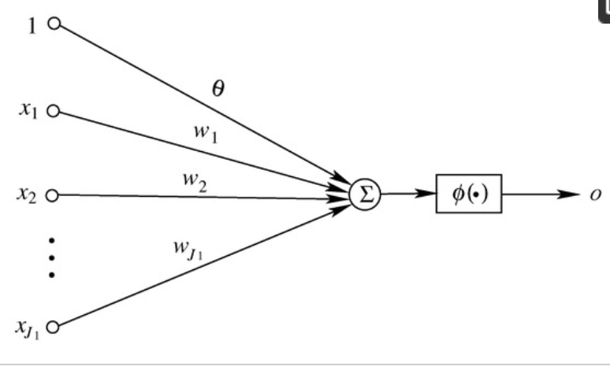
Perceptron

Slide 8
Perceptron Setup
Algorithm: weight updates when a mistake is made
Used GridSearchCV to tune hyperparameters:
- α ∈ {0.0001, 0.001}
- penalty ∈ {l2, elasticnet}
- Training with standardized features
Notes:
“For our perceptron model, the algorithm works by updating weights whenever a misclassification occurs. This makes it a simple, yet effective, approach for linear classification problems.
To improve performance, we used GridSearchCV to tune the hyperparameters. Specifically, we tested two values for the regularization strength alpha — 0.0001 and 0.001 — to see which provided better generalization.
We also compared two different penalty terms: L2, which helps prevent overfitting by shrinking weights, and ElasticNet, which combines L1 and L2 regularization.
Finally, it’s important to note that all training was done with standardized features, since the perceptron is a gradient-based algorithm and feature scaling ensures faster convergence and fair treatment of all input variables.”

Slide 9
Perceptron Results
Best params: α=0.0001, penalty=l2, early_stopping=True
Cross-validation accuracy: ~0.8012
Test accuracy: ~0.7878
Notes:
After tuning the perceptron with GridSearchCV, the best parameters we found were an alpha of 0.0001, using L2 regularization, and enabling early stopping to prevent overfitting.
With these settings, the model achieved about 80.1% accuracy during cross-validation, which means it performed consistently across different folds of the dataset.
When we tested on the hold-out test set, the accuracy was around 78.8%, which is close to the cross-validation score. This shows that the model generalizes fairly well and is not just memorizing the training data

Slide 10
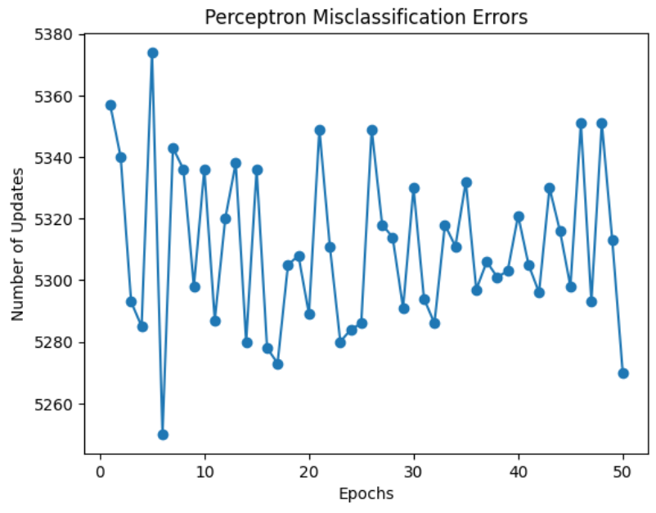
Perceptron Graph
Model is unable to converge, model is not learning correctly
Shows dataset is not linearly separable
Data cannot be clearly classified into one group or another
Need to implement a more effective model
Notes:
“So here we see the misclassification error graph for the Perceptron.
Notice how the number of updates fluctuates a lot across the epochs and doesn’t show a clear downward trend.
This tells us that the model is not converging and isn’t really learning the decision boundary effectively. The reason for this is that our dataset is not linearly separable, meaning the data can’t be split into two groups with just a straight line.
Because of that, the Perceptron struggles and makes lots of updates without improving. This result shows why we need to move on to a more advanced model, like Adaline or Logistic Regression, which can handle this situation better.”

Slide 11
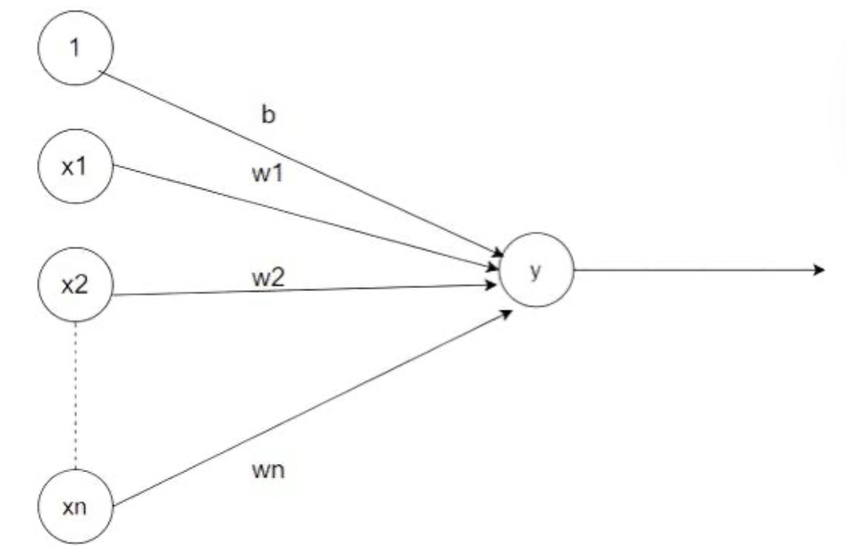
Adaline

Slide 12

Adaline Setup
Optimization: Stochastic Gradient Descent (SGD)
Parameters: η = 0.0001, n_iter = 50
Notes:
For the Adaline model, we used Stochastic Gradient Descent as the optimization method. This approach updates the weights after each training example, which makes learning faster and more scalable compared to batch gradient descent.
For our setup, we chose a learning rate of 0.0001 and trained for 50 iterations. These parameters were selected to balance stability and convergence, ensuring the model could steadily minimize error without overshooting.

Slide 13
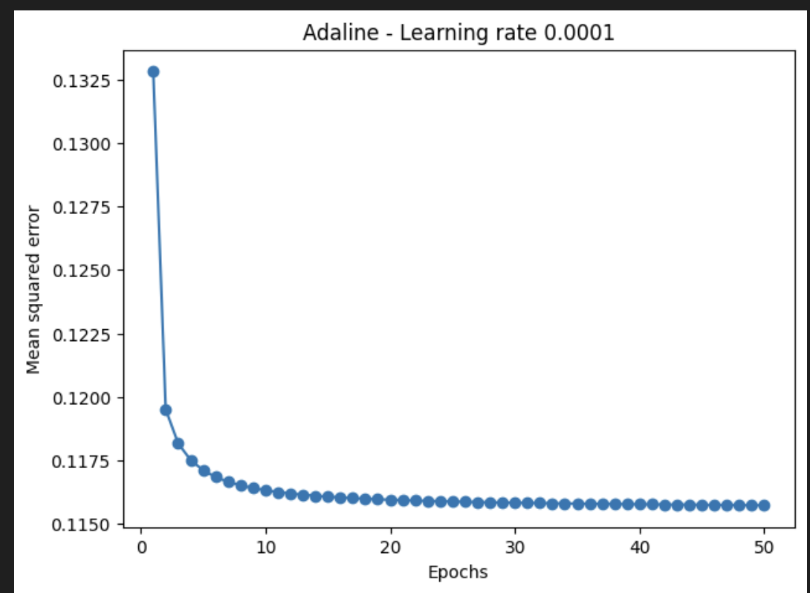
Adaline Graph
Mean Squared Error (MSE) steadily decreases with epochs
Rapid improvement in the first few iterations, then gradual convergence
Model shows stable learning behavior without oscillations or divergence
Final MSE = 0.115, indicates good fit and consistent optimization
Notes:
“On this slide, we see the Adaline graph, which tracks the Mean Squared Error, or MSE, over 50 epochs.
As shown, the MSE steadily decreases as the model trains.
There’s a rapid improvement during the first few iterations, which then transitions into a gradual convergence.
This pattern indicates that the model is learning in a stable way — there are no oscillations or signs of divergence, which means the learning rate we chose was effective.
Finally, the model converges at an MSE of around 0.115. This low error value suggests that the model achieved a good fit and consistent optimization.”

Slide 14
Adaline SGD Results
Achieved a strong test accuracy = 0.83
Model showed stable convergence with smooth error reduction
Low learning rate (η = 0.0001) prevented overshooting
Final MSE stabilized around 0.115
Outperformed the Perceptron (0.79 accuracy)
Demonstrates the advantage of SGD optimization for this dataset
Notes:
“With Adaline of about 0.83, which is higher than the Perceptron.
The model showed stable convergence, with error decreasing smoothly across epochs. By using a low learning rate of 0.0001, we prevented overshooting, which helped the model steadily minimize error.
The final MSE stabilized around 0.115, confirming that the model was learning consistently.
this shows the adaline has better performance and stability compared to the Perceptron approach.”

Slide 15
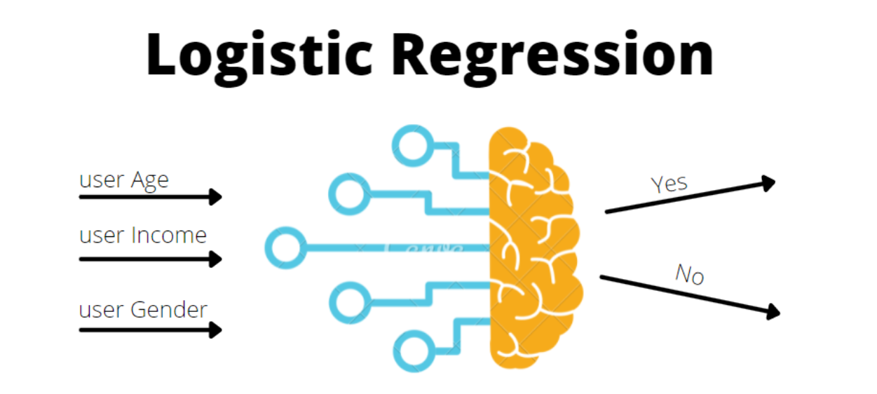
Logistic Regression
Logistic Regression models the probability that an input belongs to a certain class.
Binary classification

Slide 16
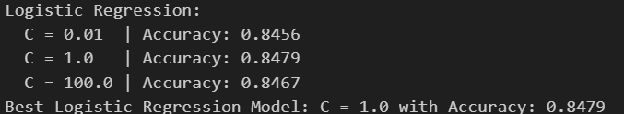
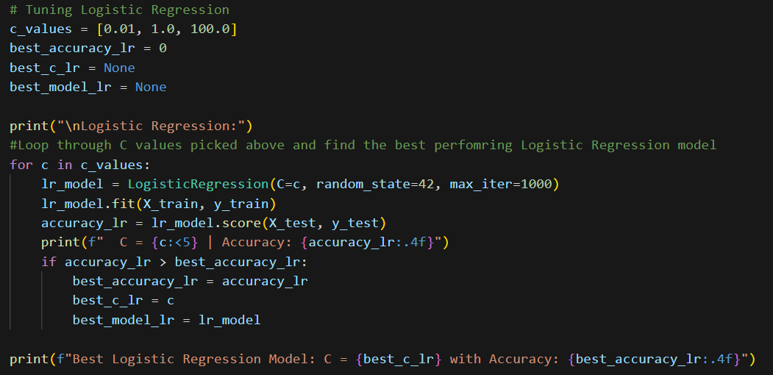
Performance and Tuning
Tested C-Values of 0.1, 1, 100, controls the strength of regularization
More regularization, more complexity to the model
Best C Value Found: 1.0
Final Test Accuracy: 84.8%
Shows large improvement over prior methods.

Slide 17
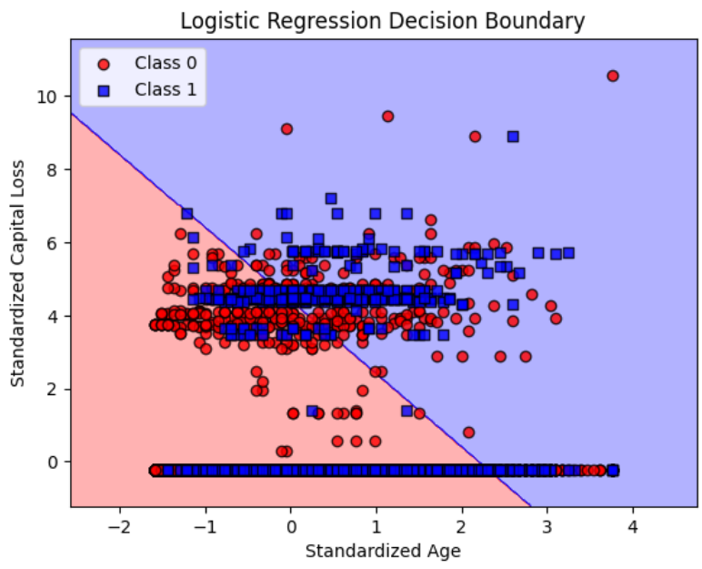
Decision Boundary – Logistic Regression
Chose to look at Age and Capital Loss
Class 0 - <= $50k
Class 1 - => $50k
Effectively shows the decision boundary

Slide 18
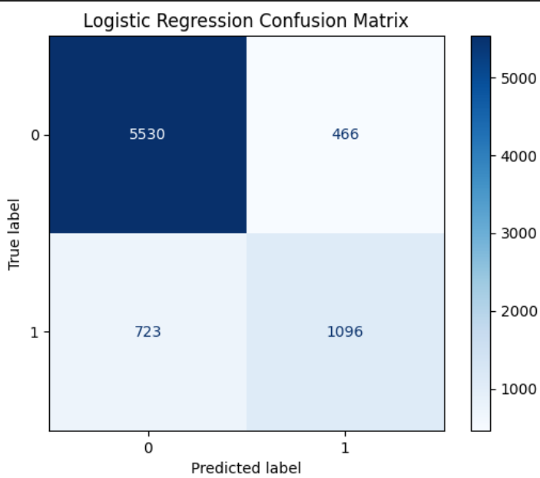
Confusion Matrix
Upper Left – True Negative
Upper Right – False Positive
Bottom Left – False Negative
Bottom Right – True Positive
The model is good at identifying class 0 data (<=50k) but struggles a little bit with class 1 (>50k), resulting in a high number of false negatives (723)

Slide 19
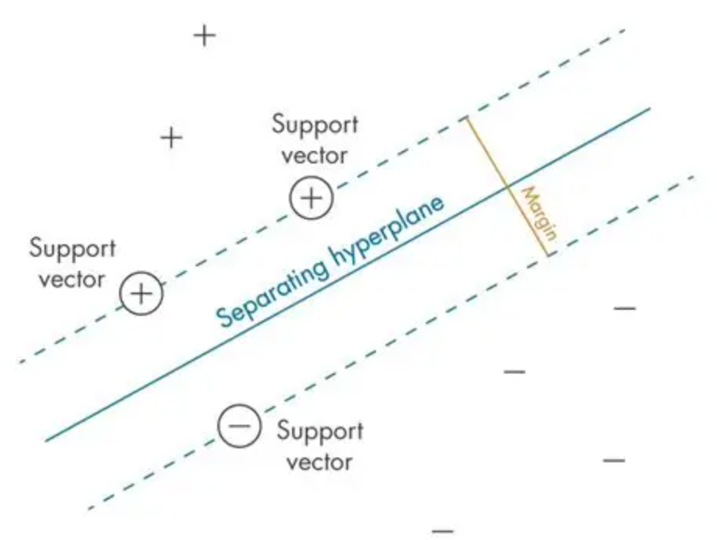
Support Vector Machine - SVM
Finds optimal separating hyperplane (maximum difference between the data points of each class)
Points are called support vectors

Slide 20
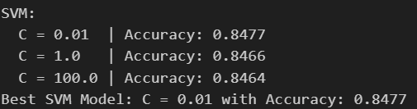
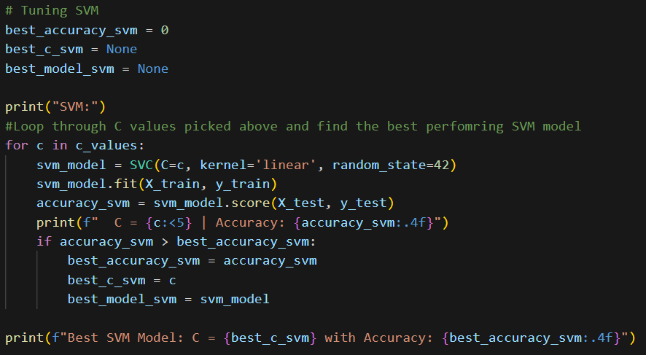
Performance and Tuning
Tested on same C Values as Logistic Regression
Best C Value for SVM : 0.01
Final Test Accuracy: 84.77%
SVM performs better with a stronger penalty

Slide 21
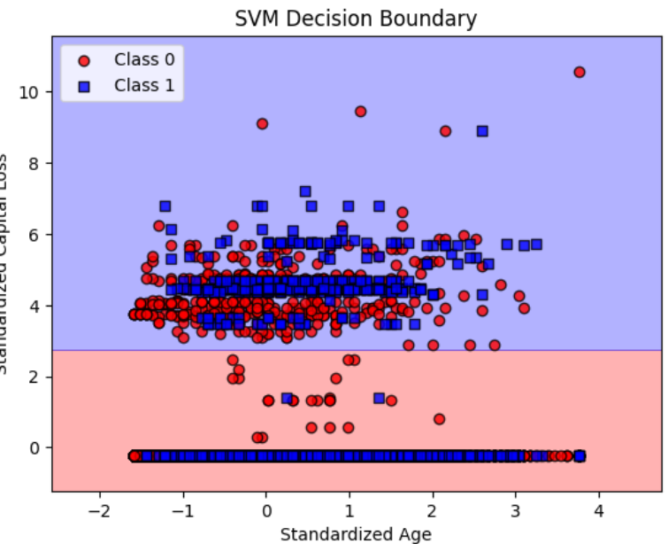
Decision Boundary - SVM
Same index as before (Age and Capital Loss)
Class 0 - <= $50k
Class 1 - => $50k
Horizontal boundary infers that when comparing these two indexes, age has little to no factor in predicting income level

Slide 22
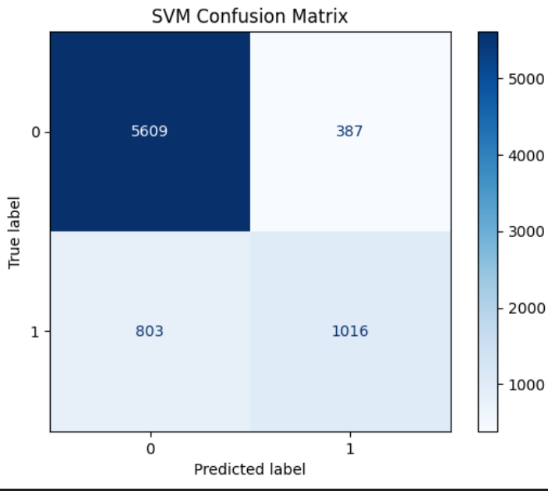
Confusion Matrix
Upper Left – True Negative
Upper Right – False Positive
Bottom Left – False Negative
Bottom Right – True Positive
Like Logistic Regression, where the model identifies class 0 well, but struggles more with class 1

Slide 23
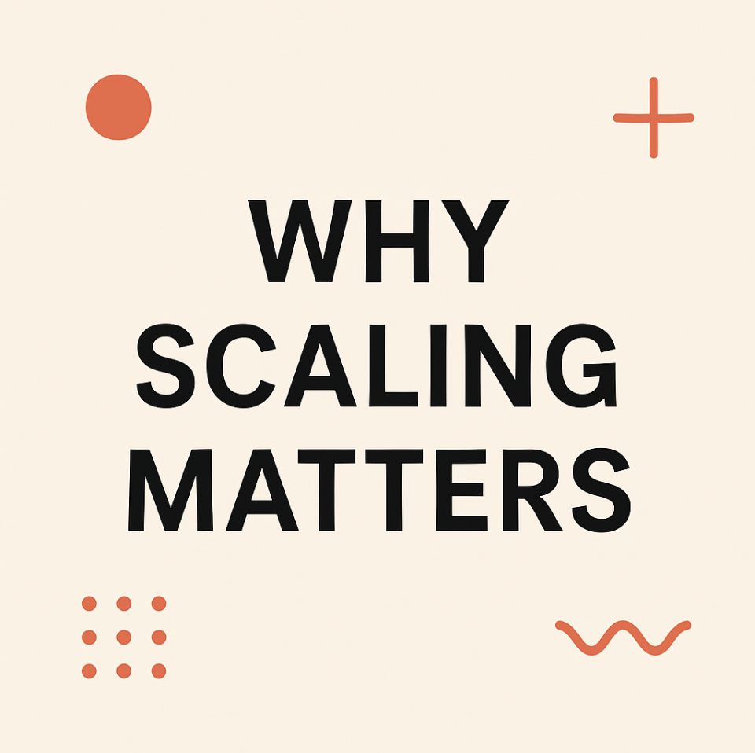
Why is feature scaling important for gradient-based algorithms?
Feature scaling standardizes the features, so the algorithms converge faster, are stable, and the decision boundaries show the real patterns and not units.
Notes:
In the dataset some of our features, like age, range from 17 to 90, while education level only goes 1 to 16. If we don’t scale them, gradient-based algorithms like Adaline and Logistic Regression treat age as much more important just because the numbers are just bigger. Scaling standardizes the features so the algorithms converge faster, are more stable, and the decision boundaries reflect real patterns instead of units.

Slide 24
Difference between batch gradient descent and stochastic gradient descent
​
Uses the entire dataset for each weight update
Smooth, stable convergence
Very slow on large datasets
Updates weights after each sample
Fast and scalable, works well for big data
Path is noisy (zig-zags to the optimum)
Batch Gradient Descent
Stochastic Gradient Descent
Notes:
Batch gradient descent uses the entire dataset for each update. That gives smooth and stable convergence, but it’s very slow when the dataset is large. But Stochastic gradient descent it updates weights after every sample, which makes it much faster and scalable, but the path bounces around and is noisier.

Slide 25

Why does scikit-learn Perceptron and Adaline outperform book code?
Book code - minimal by design (batch GD, fixed learning rate, no early stopping)
scikit-learn - optimized solvers with stochastic / mini-batch GD
Shuffling & tolerance - improves convergence stability
Regularization (L1, L2, elastic net) - reduces overfitting
Pipelines + cross-validation - prevents leakage, tunes hyperparameters
Notes:
the Perceptron and Adaline simple on purpose; they both use batch gradient descent, fixed learning rate, and barely any stopping logic. As a result, this makes these implementations more of an example. As we can see, the scikit-learn perceptron and SGDRegressor/SGDClassifier are tailored to fit the situation. We added stochastic or mini-batch gradient descent, shuffling, and regularization. Since we implemented all of these features, this has improved generalization and convergence speed, as mentioned in the textbook. They are also being fed through pipelines and are being cross-validated.

Slide 26
Decision boundaries of logistic regression and SVM
Logistic Regression: The boundary is a diagonal line, which indicates the model uses both Age and Capital Loss to make its prediction.
SVM: The boundary is a horizontal line. This implies that the SVM model, which aims to maximize the margin between classes, determines that Capital Loss is the dominant feature for separating the data in this 2D view.

Slide 27
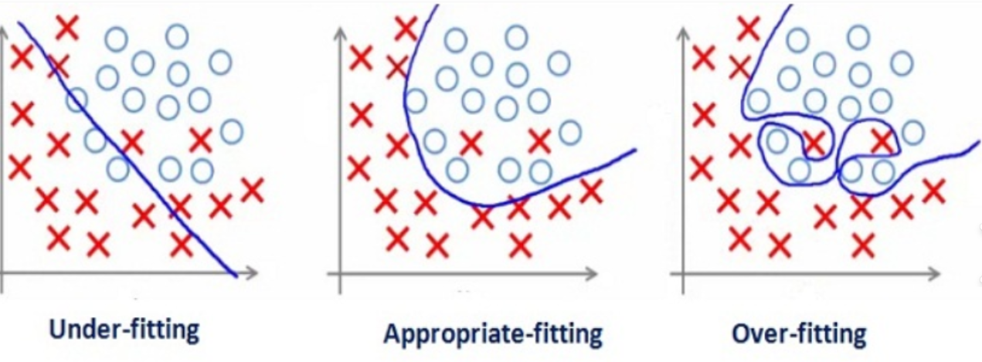
Role of regularization in preventing overfitting
Regularization adds a penalty to the model's loss function to discourage complexity
This results in a simpler model that is better at making predictions on new data.
A smaller C value applies stronger regularization, creating a simpler model.
A larger C value means weaker regularization, which can lead to a more complex model that is prone to overfitting.

Slide 28
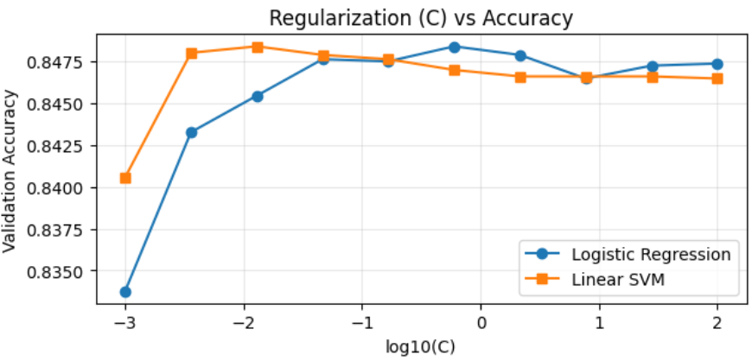
Impact of Changing C Values
On the far left (log10(C) = -3), C is very small, meaning regularization is strong. The models are too simple and perform poorly.
Accuracy for both models increases and peaks near the middle (log10(C) between -2 and 0).
On the right, C is large, meaning regularization is weak. This allows the models to become more complex, which results in a slight decrease in performance, suggesting minor overfitting

Slide 29

Thank you.

